Slide 1
Working principle of Printer interface
Md. Fazle Rabbi
ID:16CSE057

Slide 2
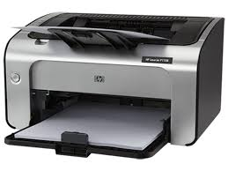
Introduction
Full form of printer is Paper Roll Ink New Tray Everyone Run which is a peripheral device.
A hardware output device accepts text and graphic output from a computer and prints a hard copy of that data.
Different printer uses different technology.
Figure 1.1: Printer

Slide 3
Printer Interfaces
Various ways to connect and communicate the printer to a computer.
Define communication type as well as the interface software
Combination of hardware and software and hardware interface is called port
Each printer has at least one interface.
Various interface are:
Serial
Parallel
USB (Universal Serial Bus)
Network
SCSI (Small Computer System Interface)
Wireless
IEEE 1394 Firewire
Infrared

Slide 4
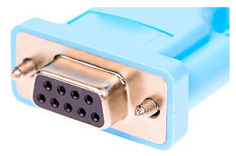
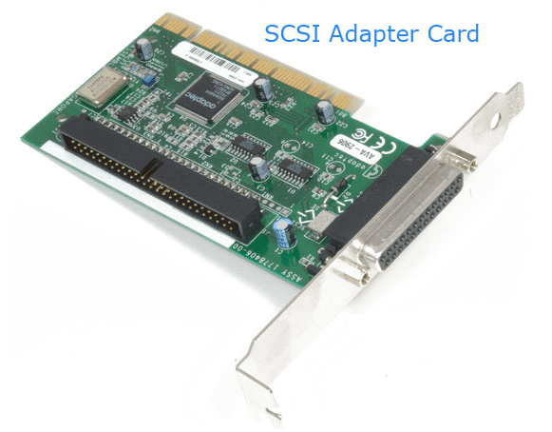
Printer Interfaces
Serial
SCSI Interface
Sent data to the printer one bit at a time.
Had to configure the start bits, stop bits, flow control, transmission rate, and parity.
Printer cable itself could be very long
Hard to configure
High-end printers where performance was an issue
SCSI-1, SCSI-2, SCSI-3
Figure 1.2: Serial Interface
Figure 1.3: SCSI Interface

Slide 5
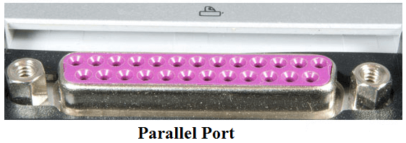
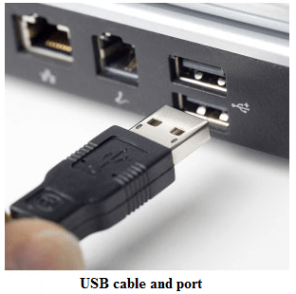
Printer Interfaces
Parallel
USB (Universal Serial Bus)
Wireless
Receives eight bits at a time over
25-pin computer interface and located on the back of computers
It replaced parallel interface.
Can connect multiple printers to our computers
Useful where connection via a cable is much difficult.
Uses a radio signal to send data to the printer and configure encryption
Figure 1.4: Parallel Interface
Figure 1.5: USB Interface

Slide 6
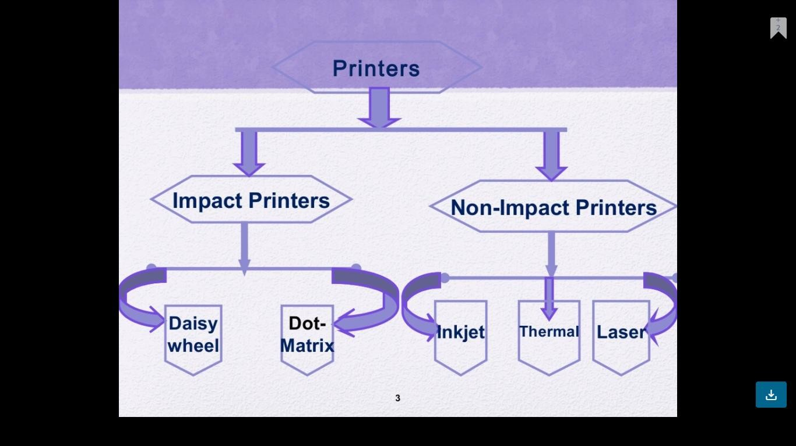

Slide 7
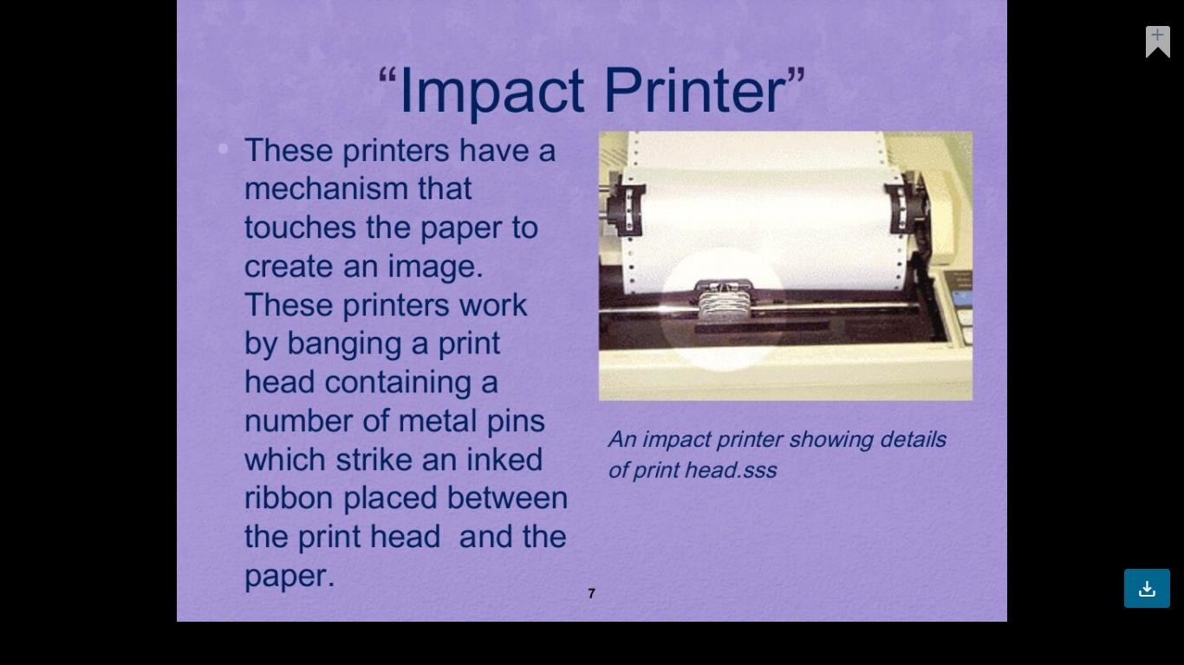

Slide 8
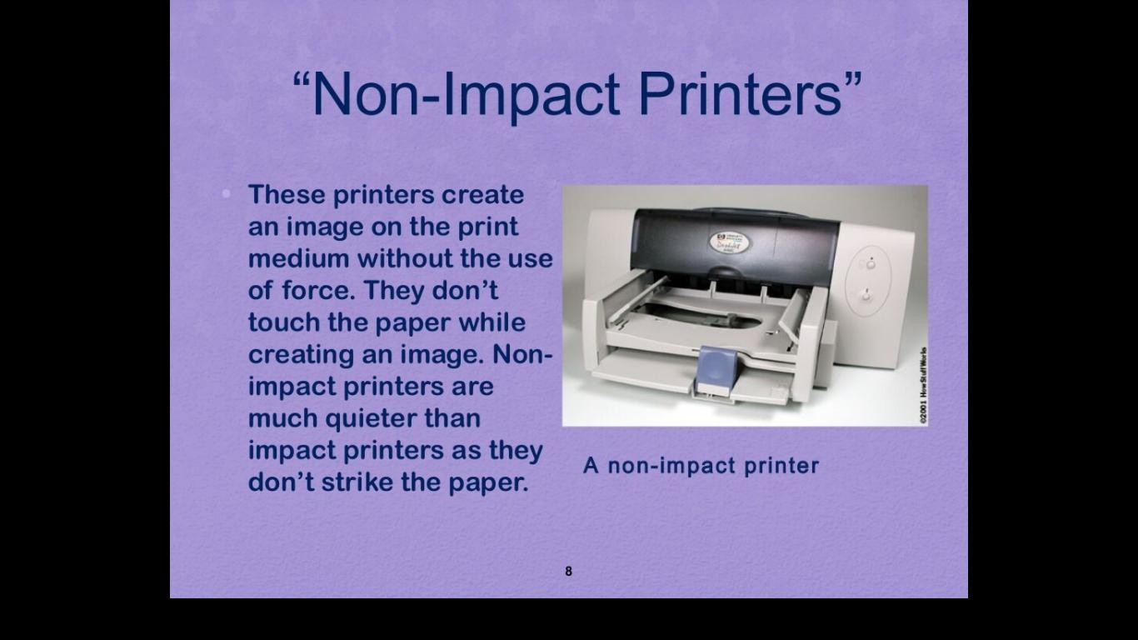

Slide 9
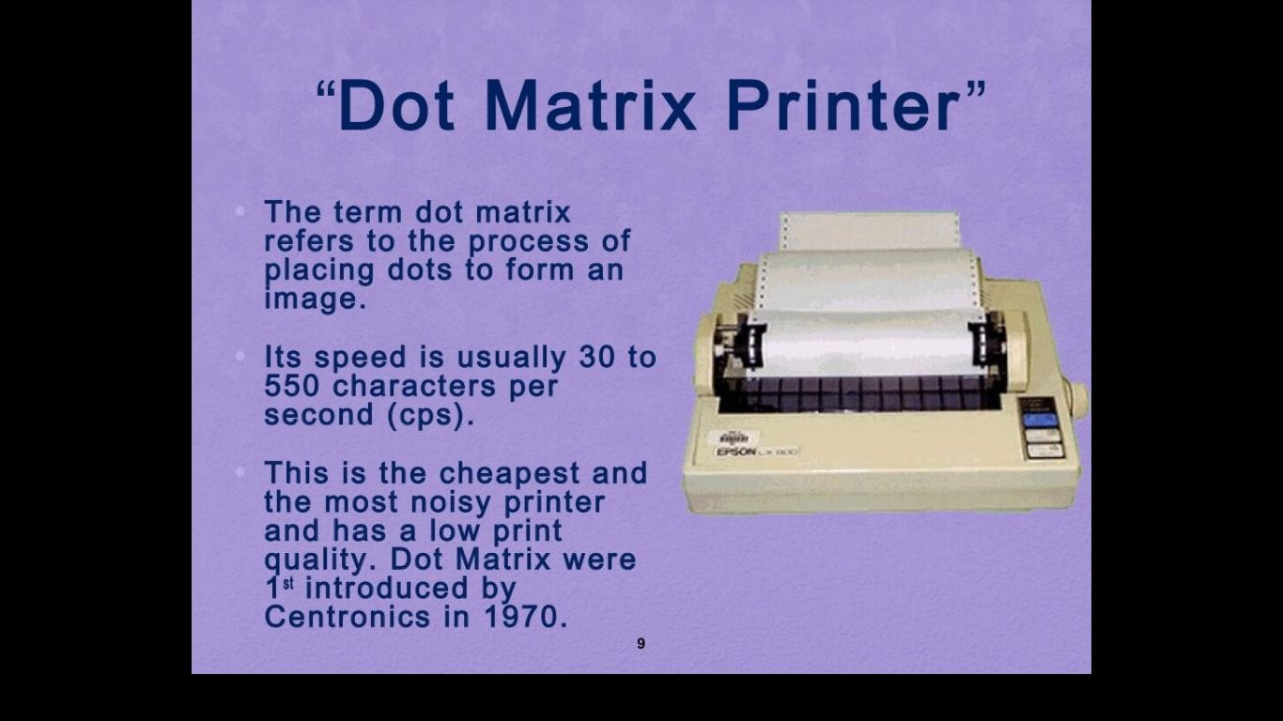

Slide 10
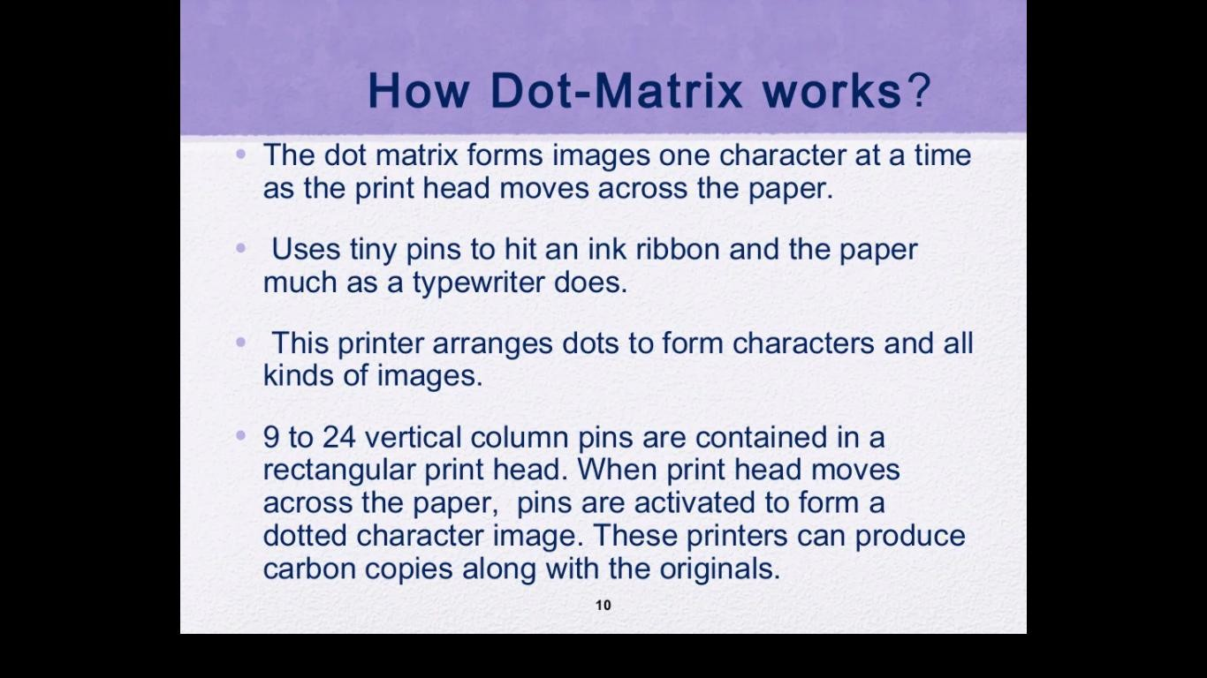

Slide 11
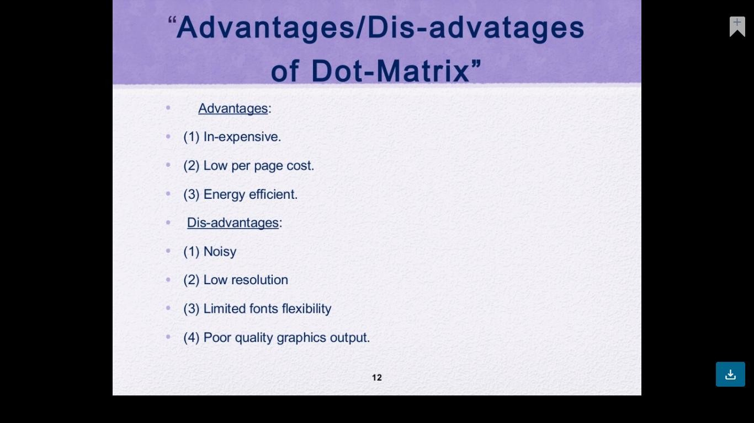

Slide 12
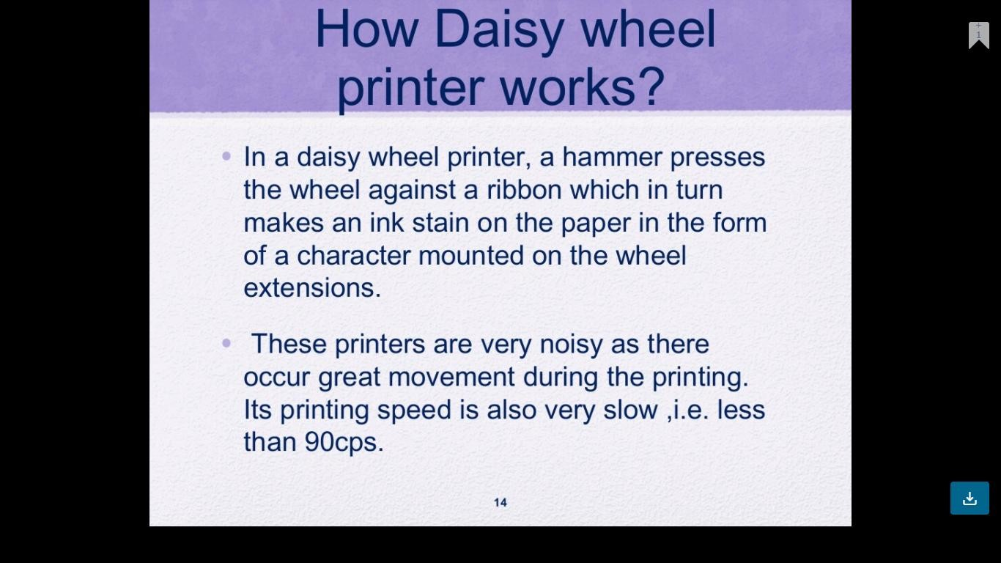

Slide 13
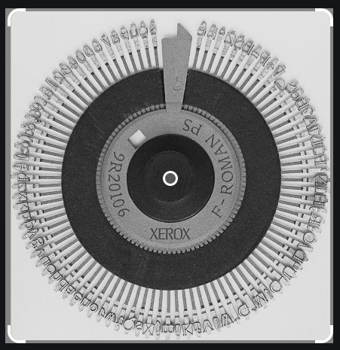

Slide 14
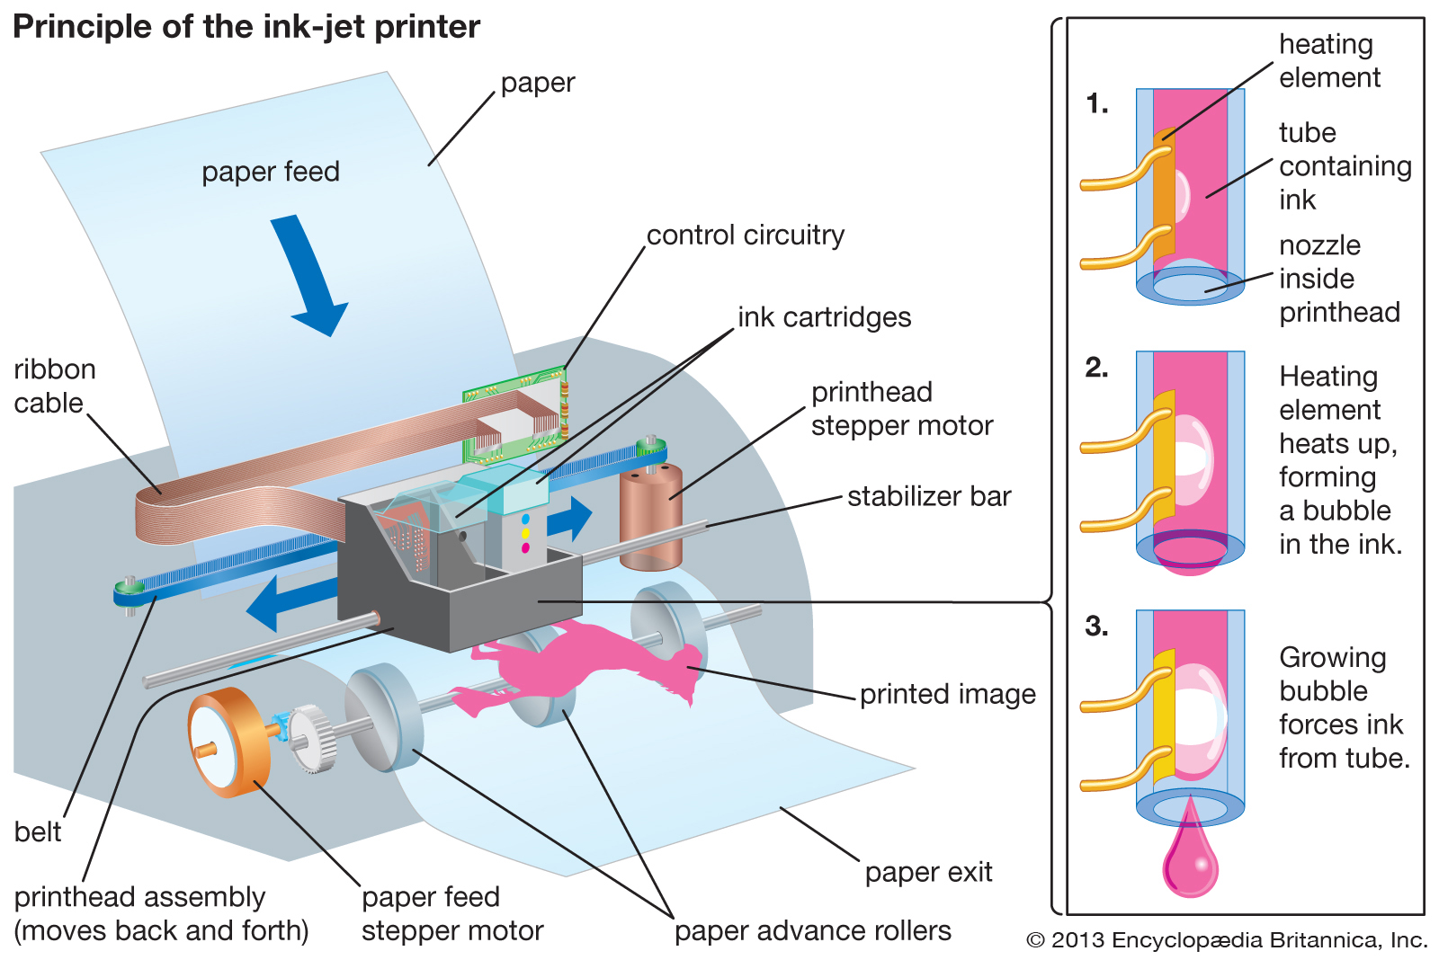
How Inkjet Printer Work
16

Slide 15
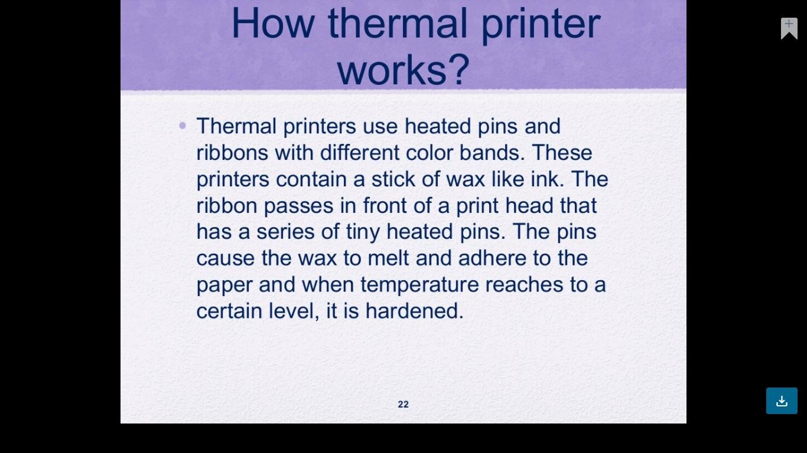
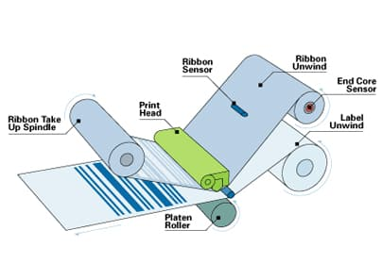

Slide 16
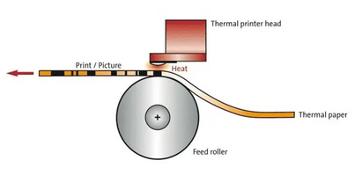

Slide 18
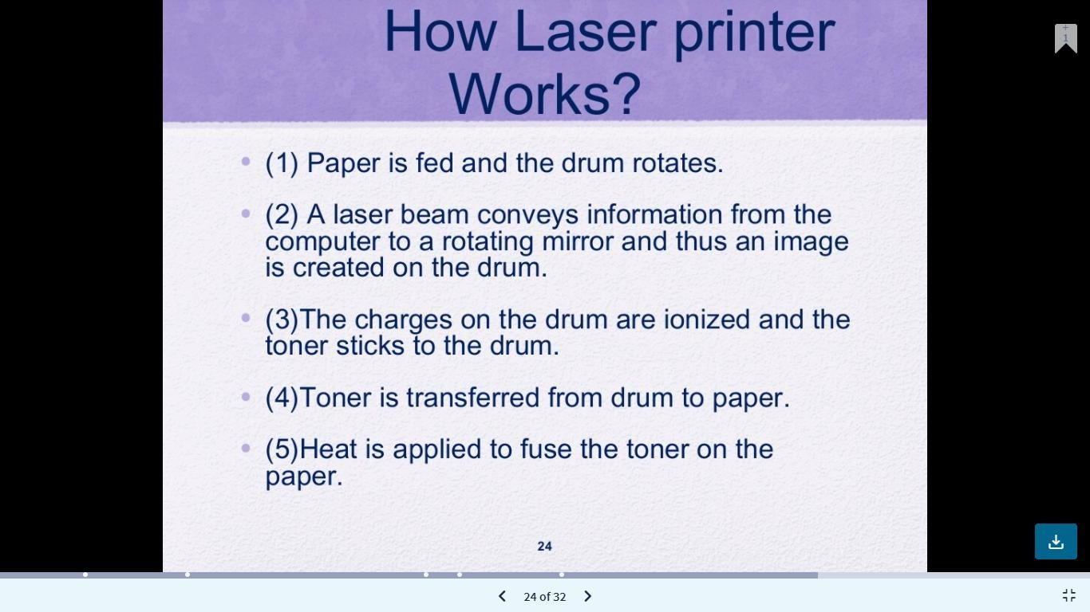
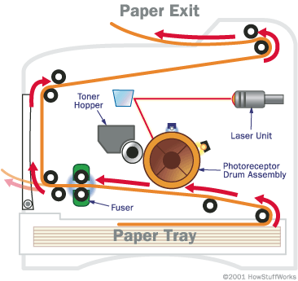

Slide 20
THE END

